Slide 1
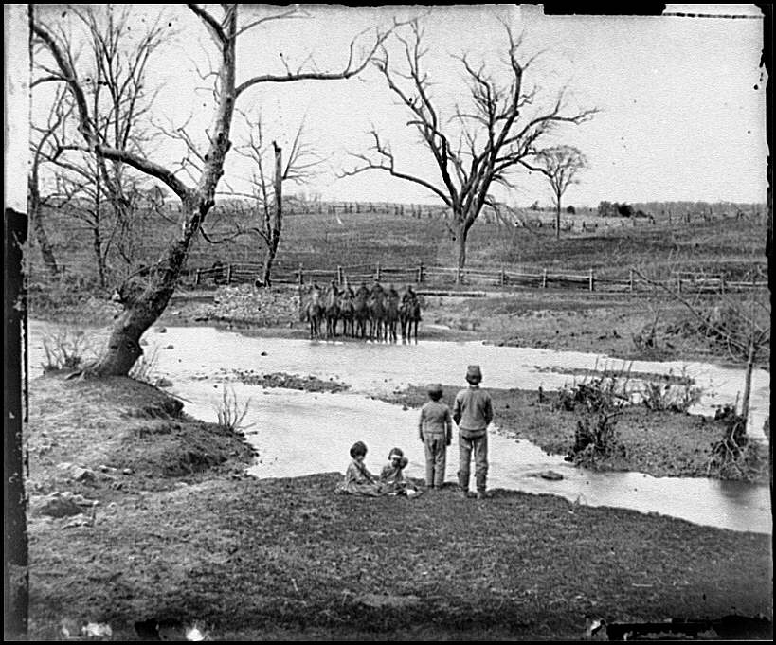
Chapter 14
The American Civil War

Slide 2
Stephan Dodson Ramseur, future Confederate general, writing from West Point (where he was a cadet) to a friend in the wake of the 1856 election: "...Slavery, the very source of our existence, the greatest blessing both for Master & Slave that could have been bestowed upon us."

Slide 3
Albert Gallatin Brown, U.S. Senator from Mississippi, speaking with regard to the several filibuster expeditions to Central America: "I want Cuba . . . I want Tamaulipas, Potosi, and one or two other Mexican States; and I want them all for the same reason -- for the planting and spreading of slavery."

Slide 4
Richard Thompson Archer (Mississippi planter): "The South is invaded. It is time for all patriots to be united, to be under military organization, to be advancing to the conflict determined to live or die in defence of the God given right to own the African"

Slide 5
Senator Robert M. T. Hunter of Virginia: "There is not a respectable system of civilization known to history whose foundations were not laid in the institution of domestic slavery."

Slide 6
Lawrence Keitt, Congressman from South Carolina, in a speech to the House on January 25, 1860: "African slavery is the corner-stone of the industrial, social, and political fabric of the South; and whatever wars against it, wars against her very existence. Strike down the institution of African slavery and you reduce the South to depopulation and barbarism…The anti-slavery party contend that slavery is wrong in itself, and the Government is a consolidated national democracy. We of the South contend that slavery is right, and that this is a confederate Republic of sovereign States."

Slide 7
Methodist Rev. John T. Wightman, preaching at Yorkville, South Carolina: "The triumphs of Christianity rest this very hour upon slavery; and slavery depends on the triumphs of the South . . . This war is the servant of slavery."

Slide 8
Georgia politician and future Confederate general, writing in the summer of 1849 to his fellow Georgian, Howell Cobb: "First then, it is apparent, horribly apparent, that the slavery question rides insolently over every other everywhere -- in fact that is the only question which in the least affects the results of the elections…I think then, 1st, that the only safety of the South from abolition universal is to be found in an early dissolution of the Union."

Slide 9
Alexander Stephens, Vice-President of the Confederacy, referring to the Confederate government: "Its foundations are laid, its cornerstone rests, upon the great truth that the negro is not equal to the white man; that slavery . . . is his natural and normal condition."

Slide 10
G. T. Yelverton, of Coffee County, Alabama, speaking to the Alabama Secession Convention on January 25, 1861: "The question of Slavery is the rock upon which the Old Government split: it is the cause of secession."

Slide 11
Secession Abounds-Response?
The country waited to see if Lincoln would respond with force
  Instead he assembles his cabinet
Lincoln recognizes his own weaknesses
  As well as the strength of his Party’s members
Lincoln will assemble a “Team of Rivals”

Slide 12
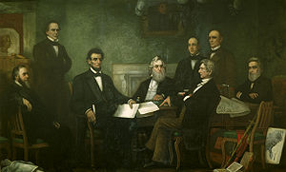

Slide 13
Team of Rivals
Lincoln’s cabinet will be comprised of his fellow Republican Presidential Candidates
  Secretary of State: William Seward
  Secretary of the Treasury: Salmon P. Chase
  Attorney General: Edward Bates
  Secretary of Navy: Gideon Wells
In his Inaugural Address Lincoln does not attack the South
  He does state firmly that Secession is illegal

Slide 14
Fort Sumter
The Southern Confederacy had taken over most Government installations in the South
  Lincoln would say that he would not try to reclaim them
Two Federal Forts remained firmly in U.S. control
  Fort Sumter in South Carolina
  Fort Pickens in Florida

Slide 15
Fort Sumter
Lincoln knew that reinforcing the forts could lead to bloodshed
  He sent naval vessels to supply those inside with food
  Confederates immediately open fire on the fort before supply vessels arrive
  Those inside, led by Major Robert Anderson, are forced to surrender

Slide 16
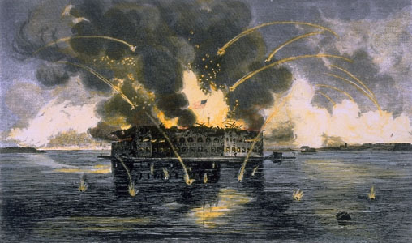

Slide 17
The Response to Sumter
Lincoln will call for 75,000 volunteers
  This prompts VA, AR, TN, and NC to secede
Civil War has officially began
  Lincoln views secession as a rejection of democracy
  Confederates view it as an expression of defending their Constitutional Rights

Slide 18
Northern Advantages
There were many factors to be considered when analyzing the war itself
  The U.S. enjoyed a population advantage
    20 Million to 9 million
  The U.S. manufactured 93% of total arms
    Enjoyed tremendous advantage of economic capacity
  The U.S. had firm control of the Navy
    Could cut off key waterways in the South

Slide 19
Southern Advantages
The Confederacy enjoyed military advantages
  The Southern states were able to fight a defensive war
    Sustain less casualties
    Easily gain sympathy from outside world
    Only need to hold the ground that they already had
  The Southern armies had much more productive and capable officers
    Most noted by historians

Slide 20
Problems Faced
Both sides had difficulties
  After Southern defections, the U.S. Army only had 13,000 officers
    Not enough to lead the 640,000 man army
    Recruitment had to be done locally
    Most soldiers were untrained and unprepared
  The Confederate Army and Government had to be constructed in a very short time
    Local groups dominated the Confederate Army
    “Richmond Howitzers” and “Tallapoosa Thrashers”

Slide 21
The Confederate States of America
Elected Jefferson Davis as president
Placed its capital city in Richmond, VA
Had a Constitution
  The Confederate Constitution supported State Sovereignty
  The Central Government had little power
    Could not even pass laws for one unified armed force

Slide 22
The Battle of First Manassas
(Bull Run)
July 21, 1861
Two armies met at Manassas Junction
  Near Bull Run Creek
Union Army led by Gen. Irvin McDowell
Confederate Army led by P.G.T. Beauregard
  McDowell swept back the Confederates’ left flank
    Victory seemed assured

Slide 23
The Battle of First Manassas
(Bull Run)
A Confederate brigade commanded by General Thomas J. Jackson stopped the Union advance
The rejuvenated Southerners pushed the Union troops back
  Union troops retreat
The inexperienced Southern Army didn’t pursue

Slide 24
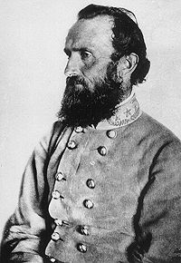
Thomas J. “Stonewall” Jackson
West Point Graduate
Born in Shenandoah Valley
Deeply religious
Considered the “Offensive Mastermind” of the Confederacy

Slide 25
The Anaconda Plan
Lincoln assigned General Winfield Scott as commander
  “Old Fuss N’ Feathers” returns
Scott devised a plan to choke off the Confederacy by blocking the Mississippi River
  Utilize superior naval power
Lincoln would accrue 500,000 more men

Slide 26
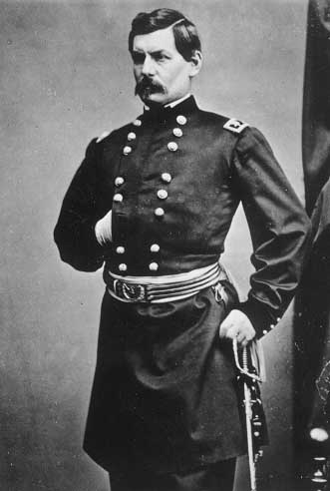
Lincoln’s New Army
This new force would be lead by
  George B. McClellan
  Considered the Young Napoleon
  Famous for driving Confederates out of Western VA
    West Virginia admitted as a state soon after

Slide 27
The War in the West
McClellan was preparing his troops for an assault on Richmond
In the West, Union General Ulysses S. Grant was beginning his campaign
  Utilized rivers to capture Ft. Donelson and Ft. Henry in TN
  His next move was an attack on Corinth, MS

Slide 28
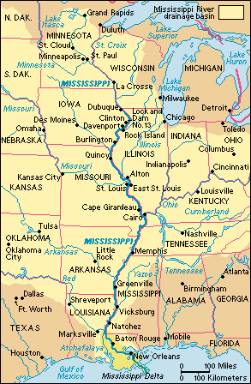

Slide 29
The Battle of Shiloh, Day 1
Confederate Army led by Albert Sidney Johnson check Grant’s advance
  Johnson’s men attack the U.S. Army at dawn
  The attack was a complete surprise
    Many died in their blankets
  At the end of Day 1, the Confederacy was in control

Slide 30
The Battle of Shiloh, Day 2
Union reinforcements come overnight
The second day of battle saw the Confederate Army overwhelmed
  They retreated to Corinth
Though the day was his, Grant would be relieved of his position for failing to pursue
  Vicksburg, MS is considered the key to controlling the Mississippi River

Slide 31
Results of Shiloh
More men died at the Battle of Shiloh than in the following combined:
  American Revolution
  War of 1812
  Mexican-American War
    Nearly 24,000 dead
    Confederate General Albert Sidney Johnston included

Slide 32
Young Napoleon’s Peninsula Campaign
McClellan determines to attack Richmond from the Southeast
  Transports his men to the tip of the James/York Peninsula
McClellan could have taken Richmond swiftly
  He is criticized for moving slowly
Confederates catch wind of the maneuver and met McClellan head on
  The Battle of Seven Pines
  No decisive winner

Slide 33
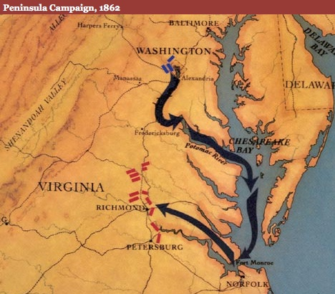

Slide 34
Seven Pines’ Greatest Legacy
Confederate General Joseph Johnston is injured in the battle
  Next in command takes over
    Robert E. Lee

Slide 35
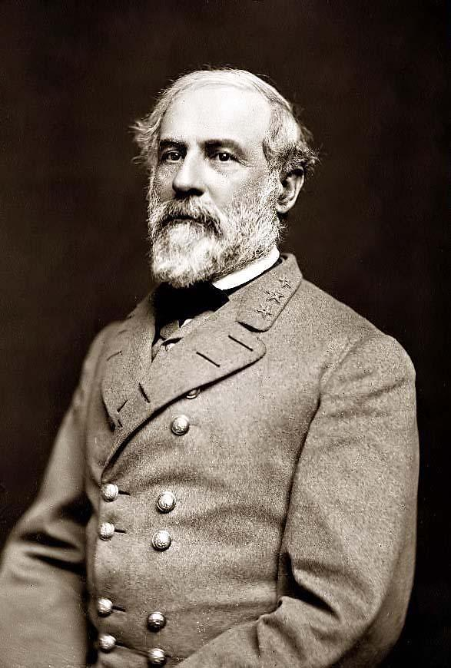
Robert E. Lee
A native Virginian
West Point Graduate
Fought in Mexican-American War
Originally offered position to lead the U.S. Army
An intelligent, deliberate General that mastered in “Battlefield Psychology”

Slide 36
The Seven Days Battle for Richmond
Lee sent “Stonewall” Jackson westward as a diversion
  Lincoln took the bait, dispatched 20,000 troops
McClellan was ordered to halt his advance
  Lee anticipated this halt and attacked
The Seven Days Battle exacted a terrible toll
  McClellan was forced to retreat

Slide 37
Results
Lincoln relieves McClellan of his duty
New General Halleck orders U.S. Troops to fall back
Small skirmishes result in high casualties
Lincoln is forced to request McClellan to return to command
  “We must use what tools we have.”

Slide 38
Lee’s Counterattack: Antietam
Lee believed that true victory was only possible with a victory on Northern Soil
  Lee divided his army in split maneuvers
  McClellan pursued Jackson moving North
    He intercepted a memo stating Lee’s plans
McClellan forces Lee to fight near Sharpsburg, MD
The battle took place on a large field
  No room for maneuvers
  22,000 dead by nightfall

Slide 39
Antietam
Lee found himself in a desperate position
  His men were exhausted, he was left with few options
An aggressive McClellan could have ended the war
  Instead, he does nothing
  An attack would pin Lee between the U.S. Army and Potomac River
  Lee escapes again and retreats into VA

Slide 40
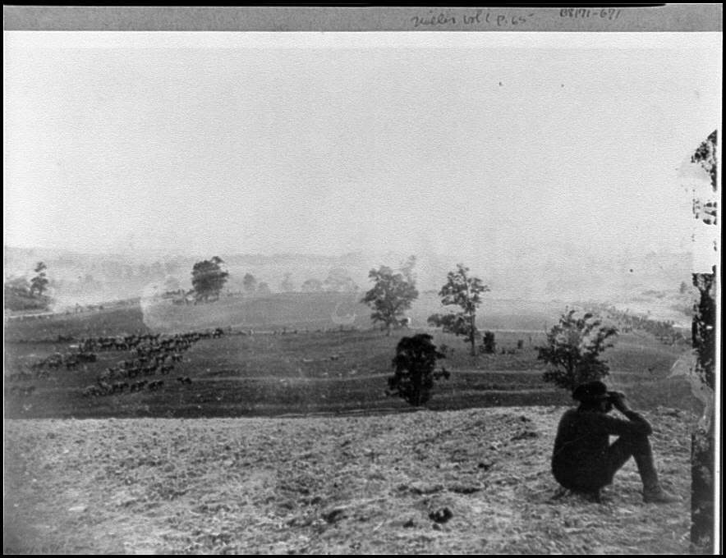

Slide 41
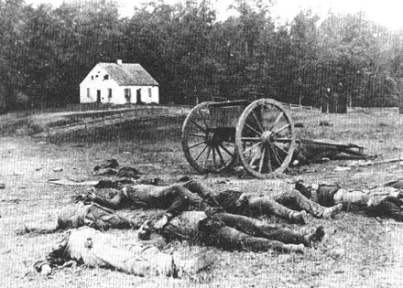

Slide 42
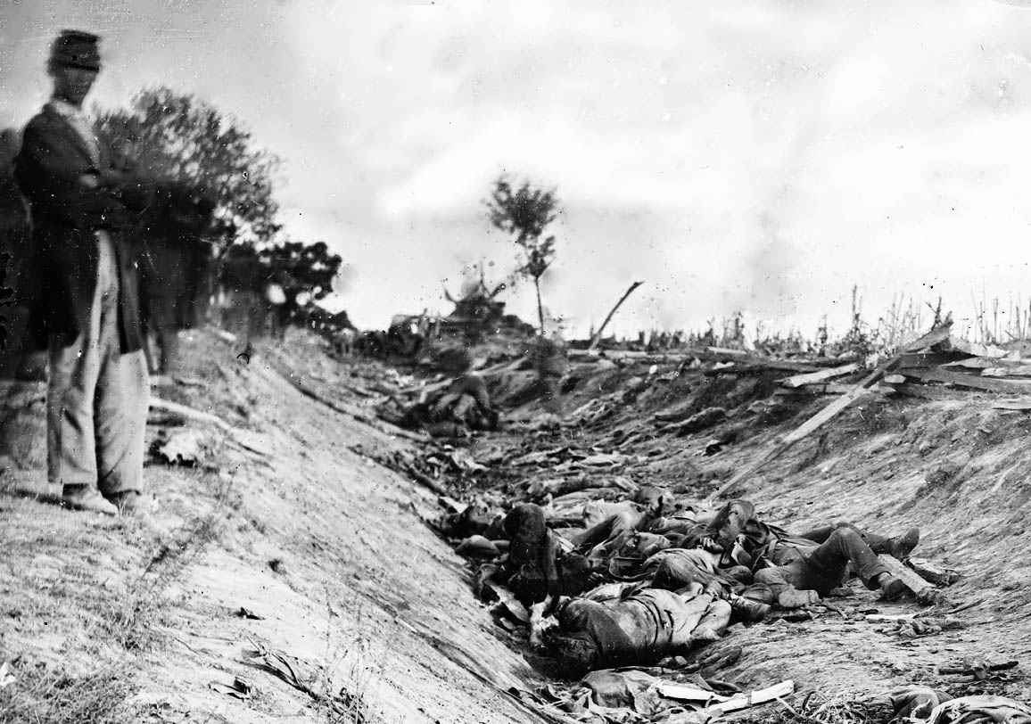

Slide 43
Results
McClellan relieved of duty once again
  This time permanently
Antietam remains the bloodiest day in U.S. History
While no clear winner emerged from the battle, Lincoln spun the engagement into a victory
  Victories allow presidents to make bold declarations

Slide 44
The Emancipation Process
Slavery remained an issue during the war
  Measures were taken to slowly end it in 1862
    April-Slavery is banned in Washington, D.C.
    June-Slavery is banned in American Territories
    July-”Confiscation Act” frees all slaves owned by those in rebellion
Lincoln would resist total emancipation because he felt it would further divide the country during a time of war

Slide 45
Why Emancipation Was Possible
Lincoln felt total emancipation was necessary
  It would garner support of European nations

Slide 46
The Emancipation Proclamation
January 1, 1863
All slaves living in areas in rebellion against the United States “shall be then, thenceforward, and forever free.”
Southerners saw it as an attempt to incite slave rebellions
Northerners abhorred slavery
  But were shocked and dismayed at the idea of equality

Slide 47
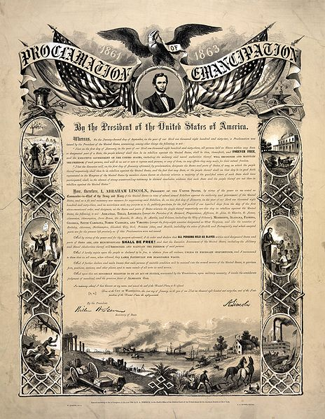

Slide 48
Political Results
Democrats made considerable progress against Republicans in the 1862 elections
Republicans were forced to support emancipation with racist arguments
The Government would begin a policy of “containment”
  Meant to keep freed slaves in the South
  Panic flooded Northern streets

Slide 49
The Conscription Act
Volunteers were beginning to run thin
The Conscription Act is passed
  Applied to all men 20-45
  Substitutes could be hired
  $300 could buy exemption
    Many claimed this unfairly benefitted the rich
The Results were not impressive
  46,000 drafted
  118,000 hired substitutes
  146,000 failed to report

Slide 50
Social Results
Riots break out in New York City
  Known as “The Draft Riots of 1863”
Donations funds raised over $40,000 to help the victims of the riots
  Some conservatives began to talk of freed slaves earning voting rights
The Union Army encountered an active plantation
  Slaves threw down their tools and flocked to the Union lines

Slide 51
African American Soldiers
Soon after Emancipation, African American soldiers were beginning to report
  By 1863, 1 in 8 Union soldiers were African American
21 Medal of Honor Recipients were African American
Confederate Soldiers showed no mercy to captured African troops
  Many POW’s were killed on site

Slide 52
The Battle Continues: Fredericksburg
Lincoln will replace McClellan with Ambrose Burnside
  Aggressive, experienced military mind
Burnside planned to attack Lee at Fredericksburg
  His plan was delayed by poor weather and low supplies
Lee was able to achieve a strong defensive position

Slide 53
Fredericksburg
Lee fortified his men behind a long stone wall located on a hill
Union Soldiers were forced to charge the Confederates uphill
  Most were mowed down
Burnside would be forced to evacuate the city
  He would be relieved of duty soon after

Slide 54
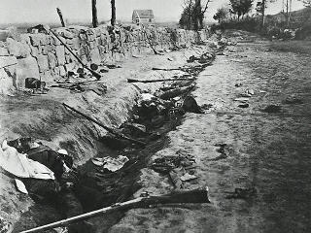

Slide 55
The Confederate’s Greatest Loss
Lincoln will assign command to “Fightin’” Joe Hooker
  Vindictive, ruthless, and devious
Hooker enjoyed a large numbers advantage
  125,000 to 75,000
A timely attack could’ve meant victory
  Hooker will delay
  Lee will send “Stonewall” Jackson to flank the U.S. Army

Slide 56
Chancellorsville
Jackson’s men caught Hooker completely off guard
  One by one his brigades were overran
Night fell before Lee could deliver the finishing blow
  Night allowed Hooker to receive reinforcements and regroup
  The following day Hooker would abandon the field and retreat

Slide 57
“I have lost my right…”
During the night, Jackson would reconnoiter the lines of the Confederate flank
  Upon his return, his own men opened fire
  Jackson was gunned down
Jackson would survive the night, but his left arm was amputated.
He would die on May 10th.
Considered the Confederate’s greatest loss of the war to that point

Slide 58
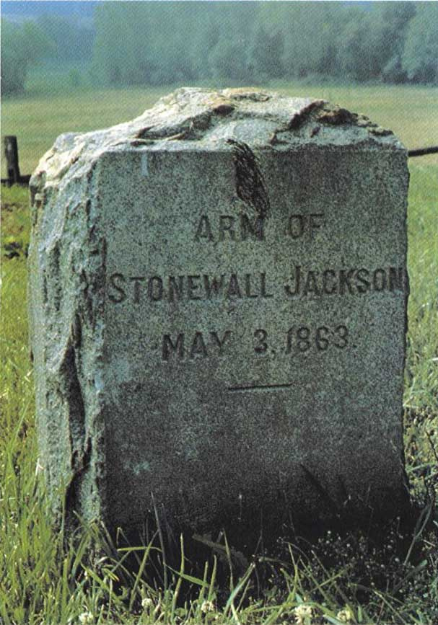

Slide 59
Lee Moves North
Lee was aware that Northern morale low
Over a fifty mile arch, Confederate soldiers entered PA
  Ranging from Chambersburg to Harrisburg
  Soldiers plundered towns and villages for supplies
A group of Confederate soldiers entered a small town in search of shoes
  Gettysburg, PA

Slide 60
Collision at Gettysburg
The small Confederate division clashed with two small Cavalry brigades
  Both sides called for reinforcements
The Union Army took position on Cemetery Ridge
  Now led by George Gordon Meade
The Confederates on Seminary Ridge
  Led by Robert E. Lee

Slide 61
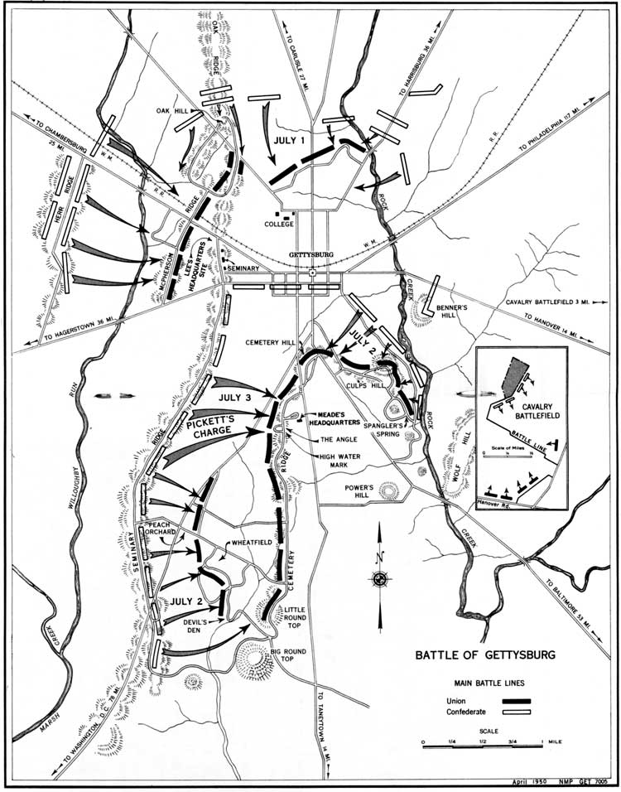

Slide 62
The Battle of Gettysburg
For two days, Confederates unleashed the largest cannon assault in American history
  They tried repeatedly to break the Union lines
  One unit actually reached the lines, but was slaughtered in the process
    Pickett’s Charge
Many believe that the fate of the Union was decided on that day

Slide 63
Results of Gettysburg
Victory for Union troops
  The first time that Lee had ever been truly defeated on the battlefield
Lee retreats into VA
  If Meade would have pursued, the Confederates would have been crushed

Slide 64
The Siege of Vicksburg
In the west, Ulysses S. Grant was closing in on Vicksburg
  He would feint however and focus secretly on Jackson, MS
    The State Capital
Grant would capture Jackson and return to Vicksburg
  He would place in under siege from May to July 4th
  The city was firmly in Union hands

Slide 65
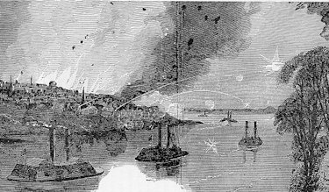

Slide 66
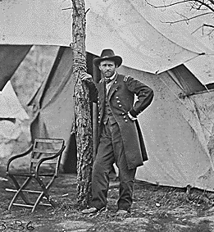
Lincoln Finds his General
President Lincoln, though originally doubtful, gave Grant command of all forces West of the Mississippi

Slide 67
Grant Continues to Succeed
Grant’s troops would earn key victories in TN
  Battle of Chickamauga
  Battle of Chattanooga
His victories allowed for the taking of Georgia
  Deemed to be essential for the Union’s success
Lincoln would summon Grant to Washington, D.C.
  Promoted him to Lt. General with supreme command of all American armies

Slide 68
Grant vs. Lee in the Wilderness
Grant would press southward as a fellow general pressed eastward to take Georgia
  William Tecumseh Sherman
Grant moved into VA to wage a ferocious battle against Lee
  The Battle of the Wilderness
Grant would unexpectedly move around Lee’s position to take Petersburg, VA

Slide 69
Siege of Petersburg
Lee was unprepared for Grant’s new maneuver
  Confederates were forced to dig trenches around the city to protect it
  Grant laid siege to the city
If Lee abandoned his position, he would leave the Confederate capital city of Richmond exposed
  That would be the equivalent to surrender

Slide 70
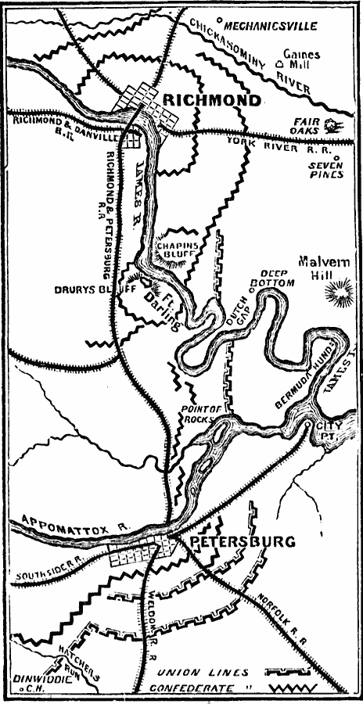

Slide 71
The Election of 1864
Support for Lincoln was wavering
  Would run for re-election on the National Union Ticket
Would be challenged by:
  Republicans: Salmon P. Chase
  Democrats: George B. McClellan
    Both ran on platform of “Peace at Any Cost”
Lincoln would need a major success to sway popular opinion

Slide 72
Sherman’s March
General Sherman was now marching through Georgia
  Mission: Conquer land and do psychological damage to the South
Sherman would march from Atlanta to the coast at Savannah
  His men burned and pillaged every small town that they encountered
  “Total War”

Slide 73
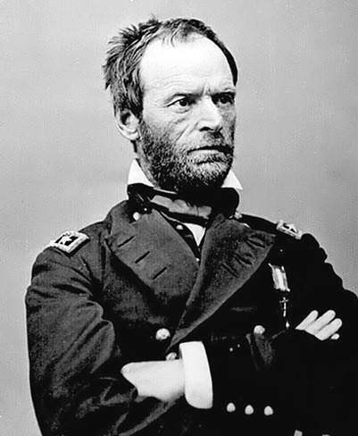
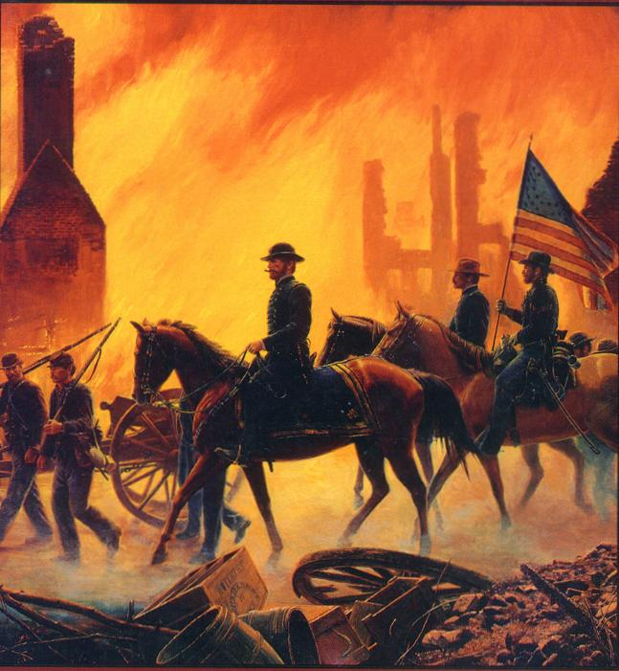

Slide 74
Sherman Rejuvenates Lincoln
Sherman’s utter destruction of Georgia raised morale across the Union
Lincoln will win reelection easily
  The nation was ready to continue the struggle
After taking Savannah, Sherman marched northward
  Took Columbia, SC with ease
  Took North Carolina next
  Sites set on Virginia

Slide 75
Lee Falters in Petersburg
The Army of Northern VA was crumbling in Petersburg
  Lee realized that he must retreat
Grant’s army moved swiftly on Richmond
  Lee was greatly outnumbered
  Richmond would fall on April 3

Slide 76
Surrender at Appomattox Courthouse
Lee would surrender at Appomattox Courthouse
  He would meet with Grant to discuss terms
Terms on surrender:
  Only requirement-Confederates lay down their arms
  No trials for treasonous actions would follow
  All done for the purposes of allowing the divided union to heal quickly.

Slide 77
